Slide 2
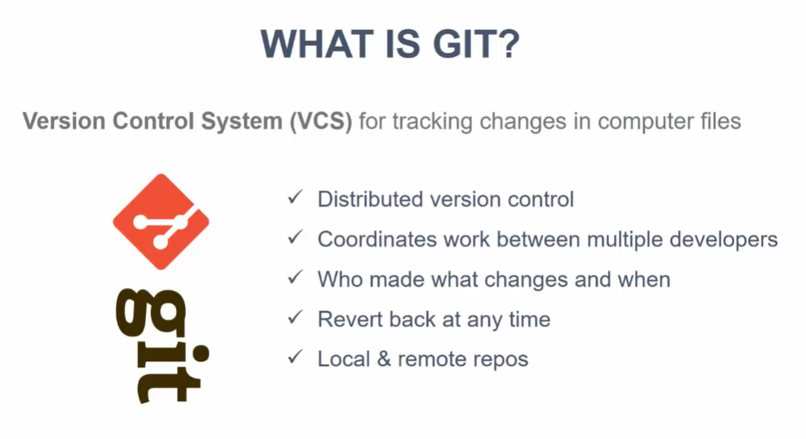

Slide 3
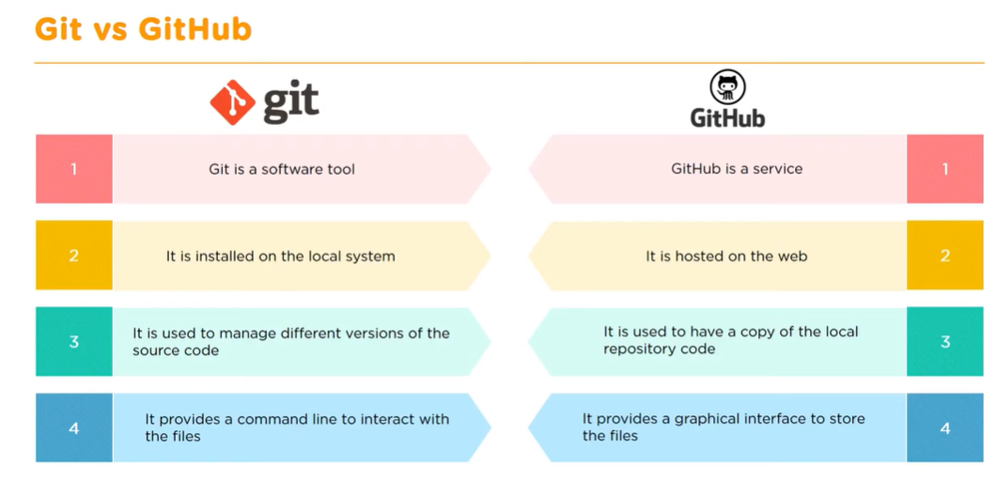

Slide 4
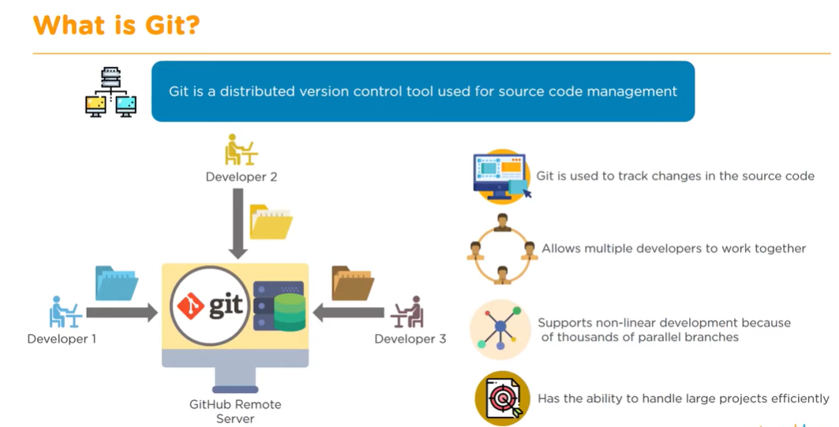

Slide 5
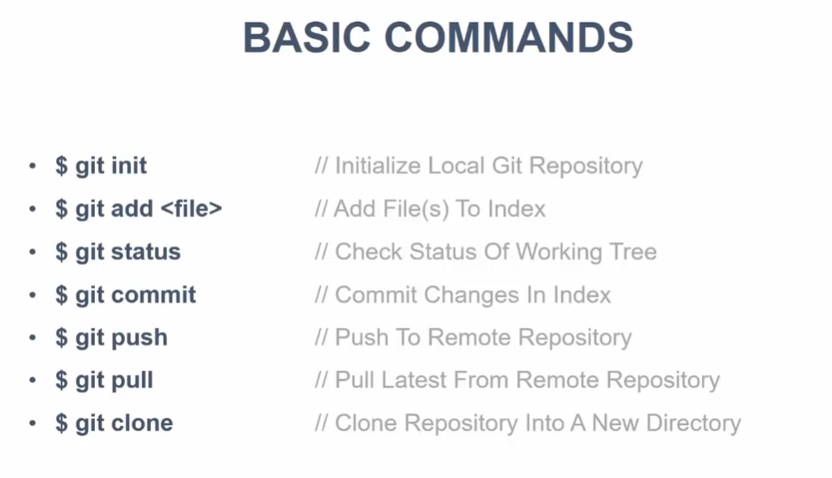

Slide 6
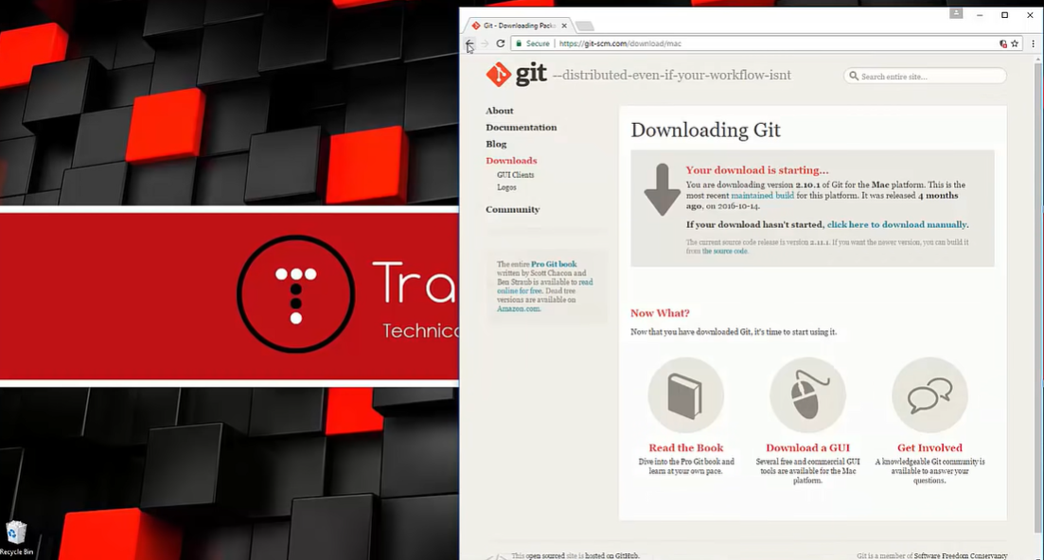

Slide 7
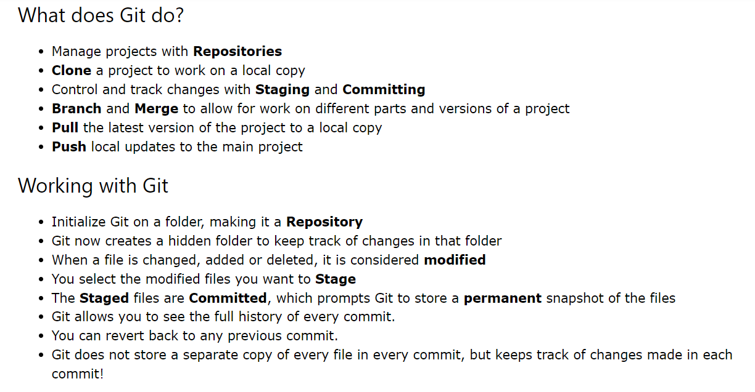

Slide 8
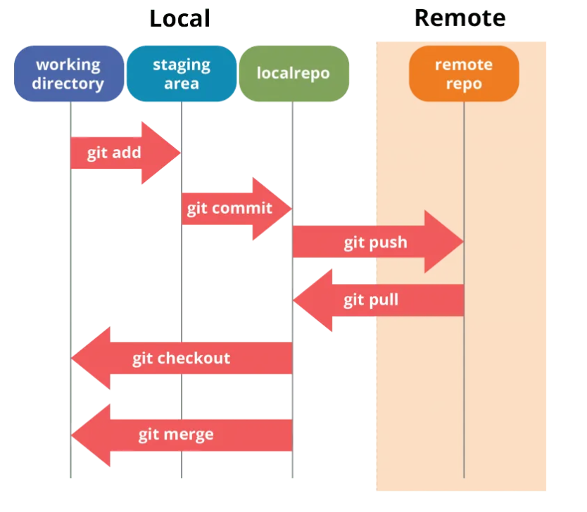

Slide 9
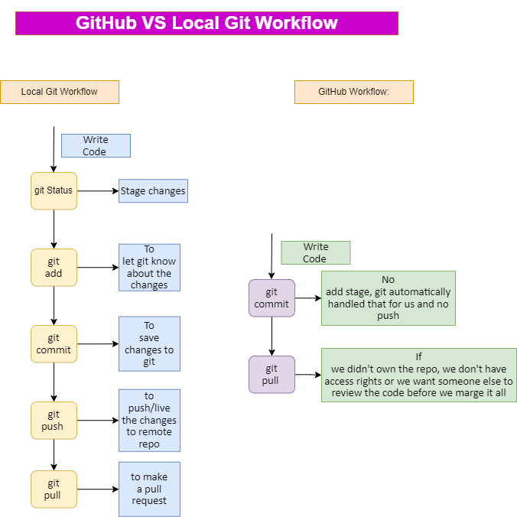

Slide 10
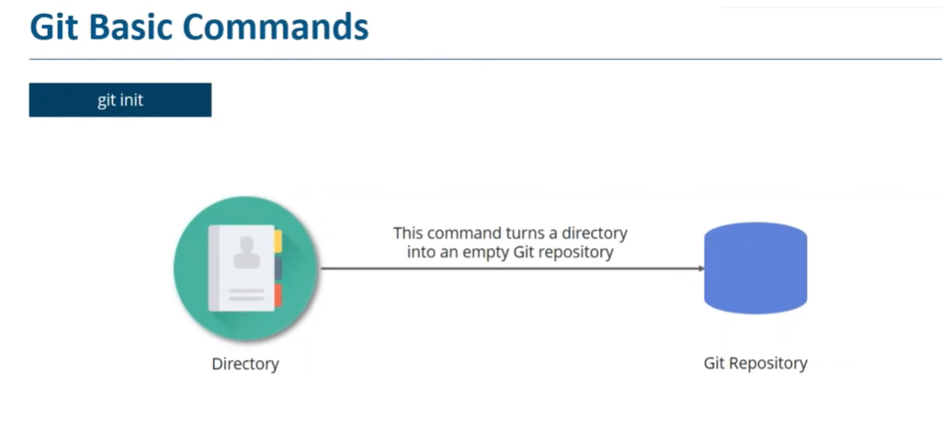

Slide 11
Setting Up Git
Once Git is installed, the first step is to set your username and email, which will be attached to your commits.
git config --global user.name "Your Name“
git config --global user.email your.email@domain.com

Slide 12
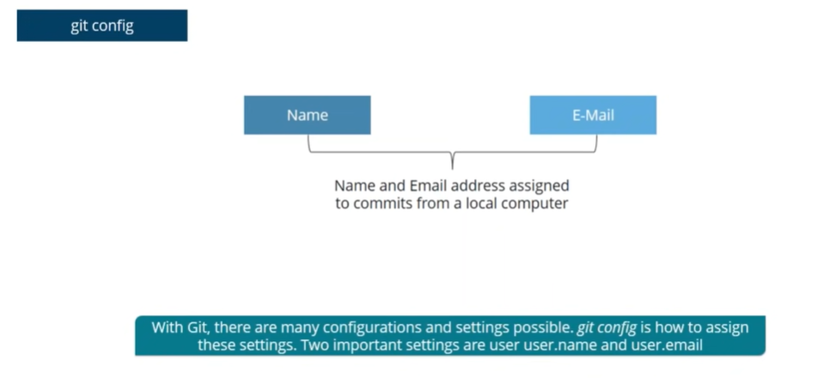

Slide 13
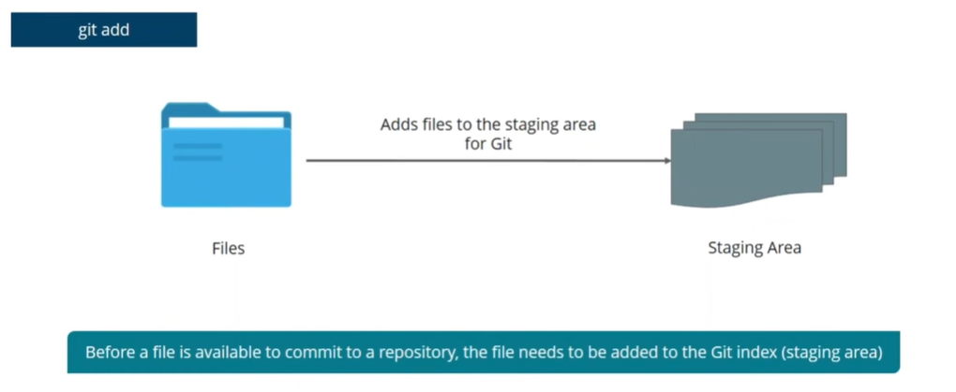

Slide 14
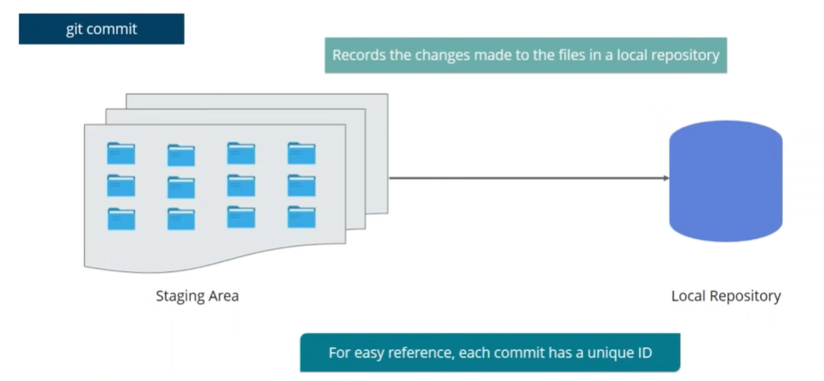

Slide 15
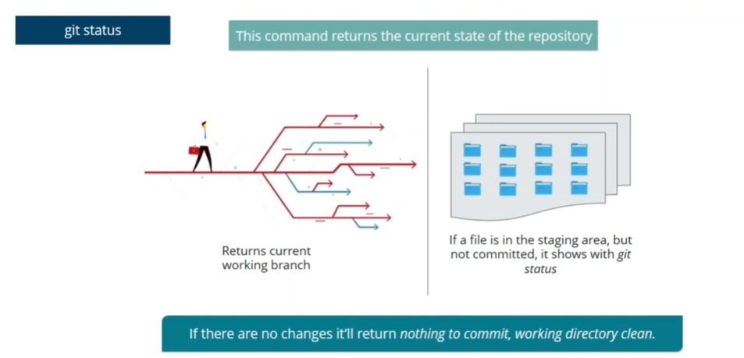

Slide 16
Git Branching:
Branching is a core concept of Git that allows you to create separate lines of development within a repository.
Each branch represents an independent line of work, enabling you to work on multiple features, bug fixes, or experiments in parallel without interfering with each other.
git branch — Lists all branches in the repository.
git branch <branch-name> — Creates a new branch.
git checkout <branch-name> — Switches to a different branch.

Slide 17
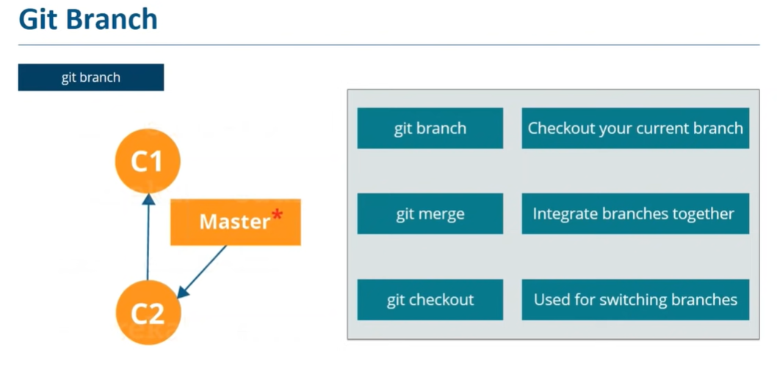

Slide 18
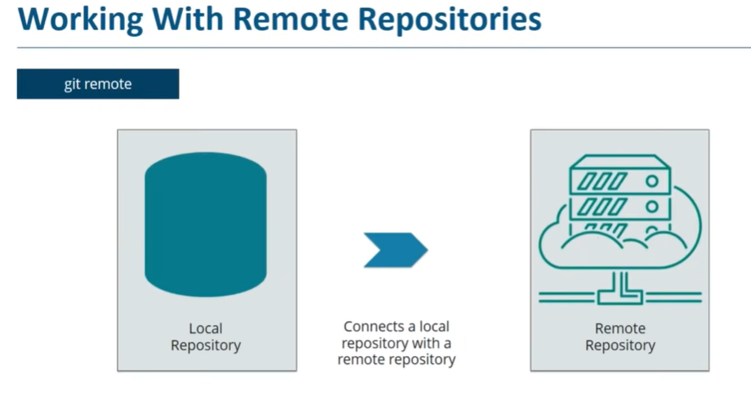

Slide 19
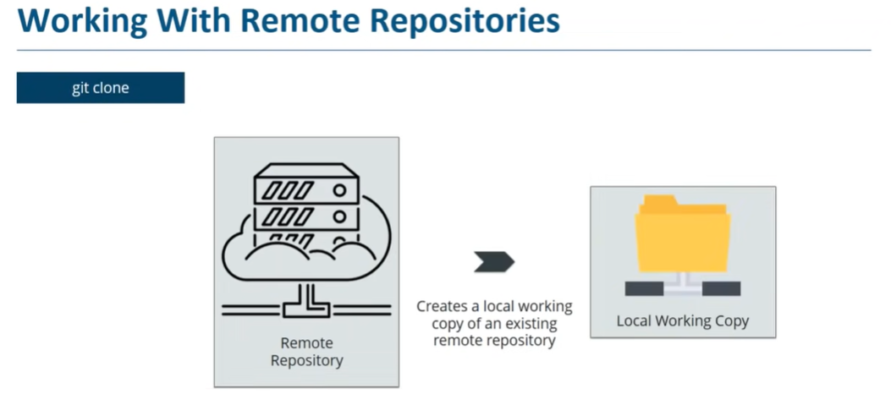

Slide 20
